Slide 1
Programming Assignment
Wang Zixiao
School of Computing
National University of Singapore
CS 4226: Internet Architecture

Slide 2
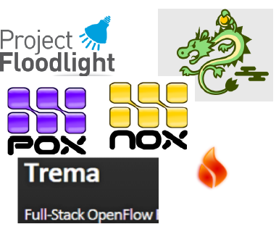
Variety of SDN Controllers
NOX/POX
Ryu
Floodlight
OpenDaylight
Pyretic
Frenetic
Procera
RouteFlow
Trema

Slide 3
POX: Overview
A platform for building network control applications using Python
Supports OpenFlow v. 1.0 API
Advantages:
Widely used, maintained, supported
Relatively easy to read and write code
Disadvantages: Performance

Slide 4
Mininet Network
Host Machine
Virtual Machine
POX
Mininet
Virtual Network
s4
s1
s2
s3
h1
h2
h3
h4
h5
h6
h7

Slide 5
Learn through an example
Implement a switch
What is a switch?
What is a hub?

Slide 6

Simple hub
Ethernet is a broadcast medium
Hub is a flooding device

Slide 7
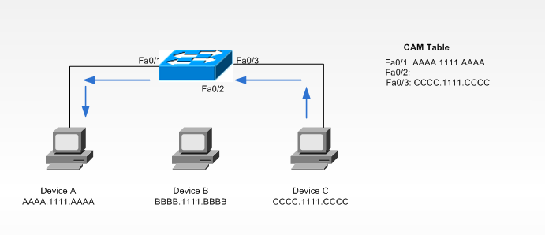
Example: Simple Switch
Switch layer 2:
A multiple port bridge
learn about the MAC addresses on each ports
passes MAC frames destined to those ports.

Slide 8



Self-learning, forwarding: example
Source: A
Dest: A’
A
A A’
Frame Destination: A’ Location: unknown
A A’
C’
B
➔ flood
6
1
2
A A’
5
4
3
Frame Destination: A
Location: 1
B’
C
A A'
A A’
A' A
➔ selectively send
on just one link
A’
A A'
MAC addr interface TTL
A
1
60
switch table
(initially empty)
A’
4
60

Slide 9

Learning Switch
Parse packet and execute control logic
First packet arrives at switch
No flow table match
“PacketIn” event fired
Packet sent to controller
Compose and send message
Write flow table entry
Second packet arrives at switch
Flow table match
Action
Msg
Listener
Control Logic
Messager
POX
PacketIn
Control Plane
OpenFlow
OpenFlow
Data Plane
OpenFlow
OpenFlow
Switch
OpenFlow
Switch
Entry 1
Mininet
OpenFlow
Switch
1
2

Slide 10
OpenFlow Flow Entry
A flow entry in the flow table looks like:
Match field: packets are matched against:
Header fields and metadata
May be wildcarded (any)
Priority: used for conflicts
Action set:
Lists of actions to apply immediately
Sets of actions to add to the action set
Modify pipeline processing (go to another flow table)
A “default” entry: table-miss entry
Match Fields | Priority | Counter | Action | Timeout

Slide 11
How it works?
Event
Listener
Controller
Step 1: Register event listeners to handle specific events (e.g. ConnectionUp, PacketIn)
Step 2: Parse packet and execute control logics
Step 3: Compose and send the OpenFlow message to the switch
def launch ():
1- core.openflow.addListenerByName("PacketIn", _handle_PacketIn)
2- core.registerNew (Tutorial)
Class Tutorial(EventMixin): //EventMixin is the class that raises events
def __init__(self):
self.listenTo(core.openflow)
core.openflow_discovery.addListeners(self)
//then implement all handlers you need….

Slide 12
Events
Packet-in: For packets that do not have a matching flow entry
Flow-Removed: For flow entries whose timeout expires
Port-status: When port configuration state changes
Connection-up: Upon connection startup

Slide 13
How it works?
Listener
Controller
Event
Control Logic
Step 1: Register event listeners to handle specific events (e.g. ConnectionUp, PacketIn)
Step 2: Parse packet and execute control logics
Step 3: Compose and send the OpenFlow message to the switch
def _handle_PacketIn (self, event):
packet = event.parsed
dst_port = table.get(packet.dst)
def _handle_ConnectioUp (self, event) :
log.debug(“Switch %s has come up.”, dpid_to_str(event.dpid))
Every switch connected to the controller has an id named dpid (data path id).

Slide 14
How it works?
Event
Listener
Control Logic
Messager
Msg
Step 1: Register event listeners to handle specific events (e.g. ConnectionUp, PacketIn)
Step 2: Parse packet and execute control logics
Step 3: Compose and send the OpenFlow message to the switch
msg = of.ofp_flow_mod() <- This instructs a switch to install a flow table entry
msg.match.dl_src = packet.src
msg.match.dl_dst = packet.dst msg.actions.append(of.ofp_action_output(port = dst_port))
event.connection.send(msg)

Slide 15
Match
in_port
dl_src, dl_dst
nw_src, nw_dst
nw_proto
tp_src, tp_dst

Slide 16
Match
Manual Match
msg = of.ofp_flow_mod()
msg.match.dl_src = packet.src
msg.match.dl_dst = packet.dst
Packet Match
msg.match = ofp_match.from_packet(packet, in_port)

Slide 17
Actions
ofp_action_output()
ofp_action_enqueue()
ofp_action_dl_addr()
ofp_action_nw_addr()

Slide 18
Example: Simple Switch
def launch ():
core.openflow.addListenerByName("PacketIn", _handle_PacketIn)
def _handle_PacketIn (event):
packet = event.parsed
dst_port = table.get(packet.dst)
msg = of.ofp_flow_mod()
msg.match.dl_src = packet.src
msg.match.dl_dst = packet.dst
msg.actions.append(of.ofp_action_output(port = dst_port))
event.connection.send(msg)
Step 1: Register event listener

Slide 19
Example: Simple Switch
def launch ():
core.openflow.addListenerByName("PacketIn", _handle_PacketIn)
def _handle_PacketIn (event):
packet = event.parsed
dst_port = table.get(packet.dst)
msg = of.ofp_flow_mod()
msg.match.dl_src = packet.src
msg.match.dl_dst = packet.dst
msg.actions.append(of.ofp_action_output(port = dst_port))
event.connection.send(msg)
Step 2: Parse the packet and execute control logics

Slide 20
Example: Simple Switch
def launch ():
core.openflow.addListenerByName("PacketIn", _handle_PacketIn)
def _handle_PacketIn (event):
packet = event.parsed
dst_port = table.get(packet.dst)
msg = of.ofp_flow_mod()
msg.match.dl_src = packet.src
msg.match.dl_dst = packet.dst
msg.actions.append(of.ofp_action_output(port = dst_port))
event.connection.send(msg)
Step 3: Compose and send OpenFlow message

Slide 21
Quality of Service
Divide the production network into logical slices
Each slice controls its own packet forwarding
Enforce strong isolation between slices
Actions in one slice do not affect another

Slide 22
QoS: Virtual Private Network (VPN)
Multiple queues for multiple classes
Guaranteed minimum bandwidth
Queue configuration is not part of the openflow
Configuration defines packet treatment
Openflow maps flows to queues
Ref:http://archive.openflow.org/wk/index.php/Slicing
Controller
DQ
Q1
Q2
Q3
Q4
Q5
IF1
OF
IF2
IF3
OpenFlow
Switch
IF1
IF4

Slide 23
VPN
Create multiple queues for each interface (or port)
Provide each queue with different bandwidth
Separate traffics into two slices and assign to different interfaces
Try to keep it simple.

Slide 24
Tips: controller
net = Mininet(topo=topo, link = TCLink, controller=lambda name: RemoteController(name, ip='pox controller ip’), listenPort=6633, autoSetMacs=True)
Fill in the field with the controller’s IP address

Slide 25
Tips: queues
sudo ovs-vsctl – set Port eth0 qos=@newqos
-- --id=@newqos create QoS type=linux-htb other-config:max-rate=1000000 queues=0=@q0,1=@q1
-- --id=@q0 create Queue other-config:max-rate=600000 other-config:min-rate=600000
-- --id=@q1 create Queue other-config:max-rate=400000 other-config:min-rate=200000
sudo ovs-vsctl --all destroy Qos
sudo ovs-vsctl --all destroy Queue

Slide 26
Tips: priority
msg.priority
Give higher priorities to more important apps

